Slide 1
Invasive/Non-Native Species
Mr. Johnson
Environmental and NRM CDE
Covington High School

Slide 3
Broom Snake Weed

Slide 5
Cheatgrass

Slide 7
Chinese tallow

Slide 9
Cogongrass

Slide 11
English Ivy

Slide 12
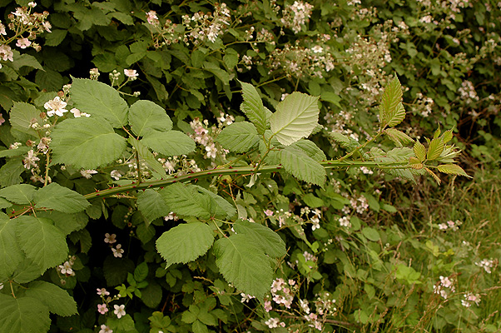

Slide 13
Himalaya Blackberry

Slide 14
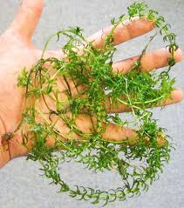

Slide 15
Hydrilla

Slide 16
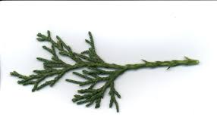
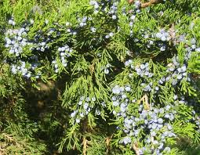

Slide 17
Juniper

Slide 18
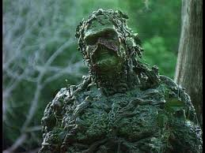

Slide 19
Kudzu

Slide 20
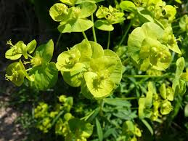

Slide 21
Leafy Spruge

Slide 22
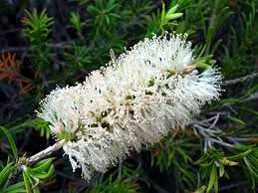
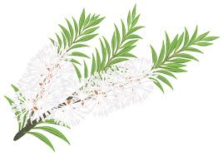

Slide 23
Melaleuca

Slide 24
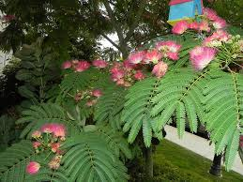

Slide 25
Mimosa Tree

Slide 26
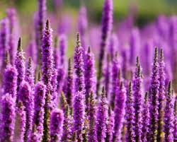

Slide 27
Purple Loosestrifle

Slide 28
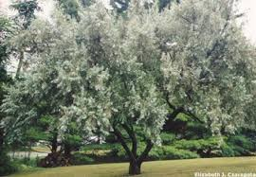
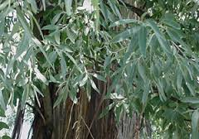

Slide 29
Russian Olive

Slide 30
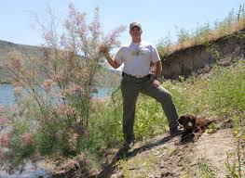

Slide 31
Saltcedar

Slide 32
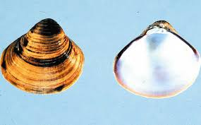

Slide 33
Asiatic Clam

Slide 35
Asian Long-Horned Bettle

Slide 36
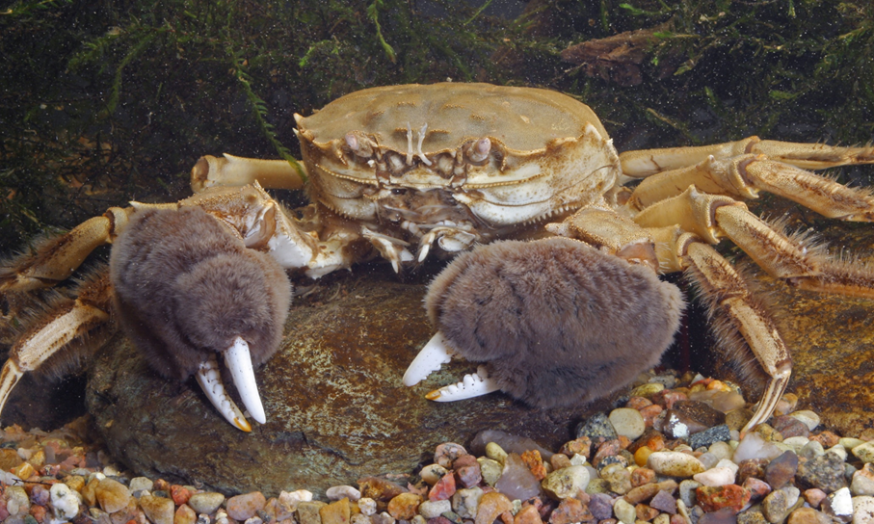

Slide 37
Chinese Mitten Crab

Slide 38
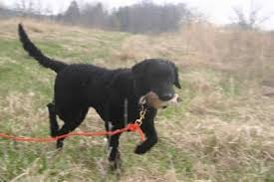
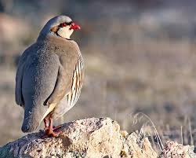

Slide 39
Chukkar

Slide 40
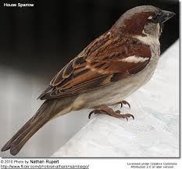
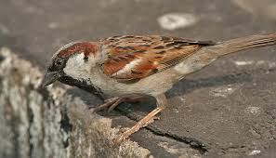

Slide 41
English Sparrow

Slide 42
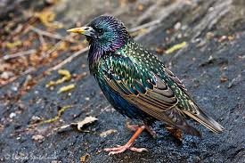
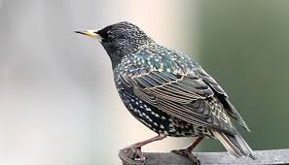

Slide 43
European Starling

Slide 44
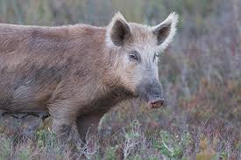

Slide 45
Feral Hog

Slide 46
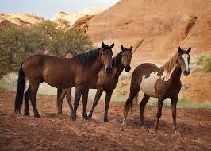

Slide 47
Feral Horse

Slide 48
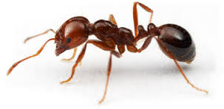
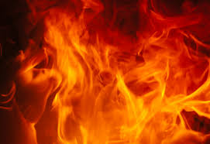

Slide 49
Fire Ant

Slide 50
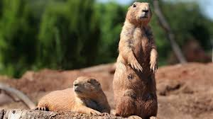

Slide 51
Gopher

Slide 52
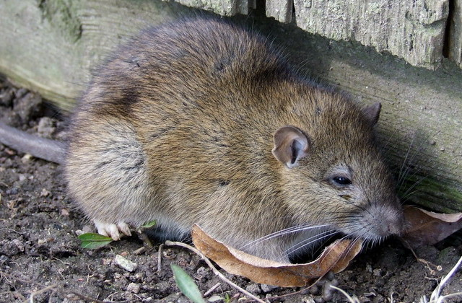

Slide 53
Norway Rat

Slide 54
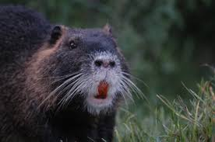

Slide 55
Nutria

Slide 57
Ring Neck Pheasant

Slide 59
Sea Lamprey

Slide 60
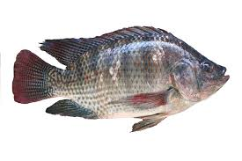
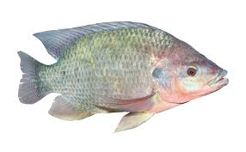

Slide 61
Tilapia

Slide 62
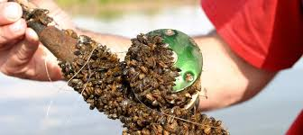
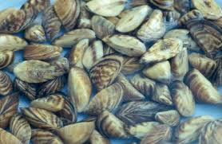

Slide 63
Zebra Mussel

